Slide 1
Adaptive Learning Platform
Phase 2: Implementation Core
Database implementation, data population and business logic
Team members
Vani Singh (25BBS0115)
Soham Anup Hippalgaonkar (25BDS0201)
Chethan Kumar Konduru (25BAI0182)
Vishnuprasad AR (25BCB0143)
Course
BACSE202 Database Systems, VIT Vellore
Faculty
Dr. Somasundaram R

Slide 2
From Phase 1 to Phase 2
Recap · Phase 1 foundation
Problem
Phase 1 group | Tables
Strong entities | users, topic, learning_item
Subclasses | quiz, project
Multivalued attribute | project_tech
Weak entity | question
Many-to-many | learning_record, topic_proficiency, recommendation
Students practise from fixed quiz and project lists that ignore past performance, so weak topics stay weak.
Approach
Record every attempt
Score each topic
Find weak topics
Recommend quizzes and projects
The Phase 1 design has 10 tables linked by 12 foreign keys, all in 3NF. Phase 2 implements it in PostgreSQL.
Adaptive Learning Platform · Phase 2 · 2

Slide 3
DDL Scripts: From Relational Model to PostgreSQL
Part 5 · Database implementation
Implementing the Phase 1 schema with keys and constraints
STEP 1
STEP 2
STEP 3
STEP 4
STEP 5
Final relational schema
→
CREATE TABLE statements
→
Keys and constraints
→
→
Schema verification
Table creation
Item | Implementation
Database | PostgreSQL
Tables | 10
Primary keys | Single-column and composite
Relationships | Implemented using 12 foreign keys
Domain constraints | difficulty and item_type
Adaptive Learning Platform · Phase 2 · 3

Slide 4
DDL Scripts for Strong Entities (1 of 2)
Part 5 · Database implementation
users
topic
CREATE TABLE users (
user_id SERIAL PRIMARY KEY,
full_name VARCHAR(100),
email VARCHAR(150) UNIQUE NOT NULL,
password_hash VARCHAR(255),
skill_level VARCHAR(15),
created_at TIMESTAMP
);
CREATE TABLE topic (
topic_id SERIAL PRIMARY KEY,
name VARCHAR(80) UNIQUE NOT NULL,
description TEXT,
parent_topic_id INT,
FOREIGN KEY (parent_topic_id)
REFERENCES topic(topic_id)
);
users: primary key, unique and required email.
topic: primary key, unique and required name, self-referencing foreign key for parent topics.
Adaptive Learning Platform · Phase 2 · 4

Slide 5
DDL Scripts for Learning Items and Subclasses
Part 5 · Database implementation
quiz
CREATE TABLE quiz (
item_id INT PRIMARY KEY
REFERENCES learning_item(item_id),
time_limit_min SMALLINT,
pass_mark SMALLINT
);
learning_item
CREATE TABLE learning_item (
item_id SERIAL PRIMARY KEY,
topic_id INT REFERENCES topic(topic_id),
title VARCHAR(150) NOT NULL,
difficulty SMALLINT
CHECK (difficulty BETWEEN 1 AND 5),
item_type VARCHAR(7)
CHECK (item_type IN ('QUIZ', 'PROJECT')),
created_at TIMESTAMP
);
project
CREATE TABLE project (
item_id INT PRIMARY KEY
REFERENCES learning_item(item_id),
est_hours NUMERIC(4,1),
repo_url VARCHAR(255)
);
Key implementation: learning_item stores the common attributes; quiz and project hold subtype-specific ones. Each subtype's primary key is also a foreign key to learning_item.
Adaptive Learning Platform · Phase 2 · 5

Slide 6
DDL Scripts for Multivalued Attributes and Weak Entities
Part 5 · Database implementation
project_tech
question
CREATE TABLE project_tech (
item_id INT NOT NULL,
tech VARCHAR(50) NOT NULL,
PRIMARY KEY (item_id, tech),
FOREIGN KEY (item_id)
REFERENCES project(item_id)
);
CREATE TABLE question (
quiz_id INT NOT NULL,
question_no SMALLINT NOT NULL,
question_text TEXT,
correct_answer TEXT,
marks SMALLINT,
PRIMARY KEY (quiz_id, question_no),
FOREIGN KEY (quiz_id)
REFERENCES quiz(item_id)
);
project_tech: stores multiple technologies per project using a composite primary key.
question: implements the Phase 1 weak entity; each question is identified by its quiz and question number.
Adaptive Learning Platform · Phase 2 · 6

Slide 7
DDL Scripts for Many-to-Many Relationships
Part 5 · Database implementation
learning_record
topic_proficiency
recommendation
CREATE TABLE learning_record (
user_id INT NOT NULL,
item_id INT NOT NULL,
attempt_no SMALLINT NOT NULL,
status VARCHAR(12),
score NUMERIC(5,2),
started_at TIMESTAMP,
completed_at TIMESTAMP,
PRIMARY KEY
(user_id, item_id, attempt_no),
FOREIGN KEY (user_id)
REFERENCES users(user_id),
FOREIGN KEY (item_id)
REFERENCES learning_item(item_id)
);
CREATE TABLE topic_proficiency (
user_id INT NOT NULL,
topic_id INT NOT NULL,
proficiency_score NUMERIC(5,2),
attempts_count INT,
last_updated TIMESTAMP,
PRIMARY KEY (user_id, topic_id),
FOREIGN KEY (user_id)
REFERENCES users(user_id),
FOREIGN KEY (topic_id)
REFERENCES topic(topic_id)
);
CREATE TABLE recommendation (
user_id INT NOT NULL,
item_id INT NOT NULL,
rank_score NUMERIC(5,4),
reason VARCHAR(200),
status VARCHAR(10),
created_at TIMESTAMP,
PRIMARY KEY (user_id, item_id),
FOREIGN KEY (user_id)
REFERENCES users(user_id),
FOREIGN KEY (item_id)
REFERENCES learning_item(item_id)
);
Key implementation: composite primary keys and foreign keys connect student activity, topic proficiency and recommendations to their records.
Adaptive Learning Platform · Phase 2 · 7

Slide 8
Schema Verification and Constraint Summary
Part 5 · Database implementation
Constraint | Application
Primary key | Uniquely identifies records
Foreign key | Maintains relationships between tables
Composite key | Identifies attempts, questions, technologies and relationship records
Unique | Prevents duplicate emails and topic names
Not null | Requires fields such as email, name and title
Check | Restricts difficulty to 1–5 and item type to QUIZ or PROJECT
Verification query
SELECT table_name
FROM information_schema.tables
WHERE table_schema = 'public'
AND table_type = 'BASE TABLE'
ORDER BY table_name;
table_name (10 rows)
learning_item, learning_record, project,
project_tech, question, quiz, recommendation,
topic, topic_proficiency, users
The Phase 1 relational schema has been translated into PostgreSQL DDL, preserving the defined tables, keys and constraints.
Adaptive Learning Platform · Phase 2 · 8

Slide 9
Populating the Database with Sample Data
Part 6 · Data Population (DML)
Using SQL DML commands to populate the Phase 1 relational schema
STEP 1
STEP 2
STEP 3
STEP 4
STEP 5
→
Insert Parent Records
→
Insert Learning Content
→
Insert Activity Records
→
Create Tables
Verify Data
INSERT statements populate all 10 tables with meaningful sample data.
Parent records are inserted before records that reference them.
Sample data covers student profiles, topics, quizzes, projects and learning activity.
Primary-key and foreign-key constraints maintain data consistency.
SELECT queries verify successful population.
Adaptive Learning Platform · Phase 2 · 9

Slide 10
Populating Strong Entities — Users and Topics
Part 6 · Data Population (DML)
users
topic
INSERT INTO users
(full_name, email, password_hash,
skill_level, created_at)
VALUES
('Riya Sharma', 'riya@example.edu',
'demo_hash_001', 'Beginner',
'2026-10-01 09:00:00'),
('Arjun Mehta', 'arjun@example.edu',
'demo_hash_002', 'Intermediate',
'2026-10-01 09:15:00'),
('Maya Iyer', 'maya@example.edu',
'demo_hash_003', 'Advanced',
'2026-10-01 09:30:00');
-- Parent topics first
INSERT INTO topic
(name, description, parent_topic_id)
VALUES
('Programming Fundamentals',
'Core programming concepts', NULL),
('Database Systems',
'Relational database concepts', NULL);
-- Then child topics
INSERT INTO topic
(name, description, parent_topic_id)
VALUES
('Arrays', 'Array operations and traversal', 1),
('SQL Queries', 'Filtering, joins and aggregation', 2);
Student and topic records form the base data referenced by learning items, performance records and recommendations.
Password values are demonstration placeholders, not secure hashes; real accounts must store securely hashed passwords.
Adaptive Learning Platform · Phase 2 · 10

Slide 11
Populating Learning Items
Part 6 · Data Population (DML)
learning_item
Item ID* | Learning item | Topic ID | Type
1 | Array Basics | 3 | QUIZ
2 | SQL Joins | 4 | QUIZ
3 | Student Task Tracker | 2 | PROJECT
4 | Array Practice Lab | 3 | PROJECT
INSERT INTO learning_item
(topic_id, title, difficulty,
item_type, created_at)
VALUES
(3, 'Array Basics', 2, 'QUIZ',
'2026-10-02 10:00:00'),
(4, 'SQL Joins', 3, 'QUIZ',
'2026-10-02 10:15:00'),
(2, 'Student Task Tracker', 4, 'PROJECT',
'2026-10-02 11:00:00'),
(3, 'Array Practice Lab', 2, 'PROJECT',
'2026-10-02 11:30:00');
*IDs assume an empty table with its sequence starting at 1.
Constraints demonstrated: each learning item has a primary key, a topic reference, a difficulty between 1 and 5, and a valid item type.
Adaptive Learning Platform · Phase 2 · 11

Slide 12
Populating Subclass Tables — Quiz and Project
Part 6 · Data Population (DML)
quiz
project
INSERT INTO quiz
(item_id, time_limit_min, pass_mark)
VALUES
(1, 15, 60),
(2, 20, 70);
INSERT INTO project
(item_id, est_hours, repo_url)
VALUES
(3, 8.0,
'https://github.com/example/task-tracker'),
(4, 4.5,
'https://github.com/example/array-practice');
Quiz records store time limits and passing marks.
Project records store estimated completion time and repository links.
Each row references an existing learning_item through item_id.
Adaptive Learning Platform · Phase 2 · 12

Slide 13
Populating Project Technologies and Questions
Part 6 · Data Population (DML)
project_tech
question
INSERT INTO project_tech
(item_id, tech)
VALUES
(3, 'Python'),
(3, 'PostgreSQL'),
(4, 'Python'),
(4, 'Git');
INSERT INTO question
(quiz_id, question_no, question_text,
correct_answer, marks)
VALUES
(1, 1, 'What is the first index of an array?',
'0', 2),
(1, 2, 'What is the process of visiting array elements?',
'Traversal', 3),
(2, 1, 'Which SQL operation combines matching rows?',
'JOIN', 2),
(2, 2, 'Which clause filters grouped results?',
'HAVING', 3);
Projects can have multiple associated technologies.
Each question belongs to an existing quiz.
Composite keys prevent duplicate technologies per project and duplicate question numbers within a quiz.
Adaptive Learning Platform · Phase 2 · 13

Slide 14
Populating Learning Records
Part 6 · Data Population (DML)
learning_record
What this data demonstrates
INSERT INTO learning_record
(user_id, item_id, attempt_no, status,
score, started_at, completed_at)
VALUES
(1, 1, 1, 'completed', 85.00,
'2026-10-03 10:00:00', '2026-10-03 10:15:00'),
(1, 2, 1, 'completed', 55.00,
'2026-10-03 11:00:00', '2026-10-03 11:20:00'),
(2, 1, 1, 'completed', 62.00,
'2026-10-04 09:00:00', '2026-10-04 09:15:00'),
(2, 1, 2, 'completed', 82.00,
'2026-10-05 09:00:00', '2026-10-05 09:15:00'),
(3, 3, 1, 'submitted', 90.00,
'2026-10-05 14:00:00', '2026-10-05 16:00:00');
Students can attempt the same item multiple times.
Each attempt records a status, score and timestamps.
The composite primary key identifies each attempt uniquely.
Records give historical performance data for topic analysis and recommendations.
Adaptive Learning Platform · Phase 2 · 14

Slide 15
Populating Topic Proficiency and Recommendations
Part 6 · Data Population (DML)
topic_proficiency
recommendation
INSERT INTO topic_proficiency
(user_id, topic_id, proficiency_score,
attempts_count, last_updated)
VALUES
(1, 3, 85.00, 1, '2026-10-05 10:00:00'),
(1, 4, 55.00, 1, '2026-10-03 11:20:00'),
(2, 3, 82.00, 2, '2026-10-05 09:15:00'),
(3, 2, 90.00, 1, '2026-10-05 16:00:00');
INSERT INTO recommendation
(user_id, item_id, rank_score,
reason, status, created_at)
VALUES
(1, 2, 0.9700,
'Low proficiency in SQL Queries',
'active', '2026-10-06 09:00:00'),
(1, 4, 0.8200,
'Additional array practice',
'active', '2026-10-06 09:00:00'),
(2, 3, 0.9000,
'Practice through a programming project',
'active', '2026-10-06 09:05:00'),
(3, 2, 0.7500,
'Strengthen SQL query skills',
'active', '2026-10-06 09:10:00');
topic_proficiency records each student's proficiency per topic; recommendation stores suggested items with a rank score, reason and status. These are demonstration records, not the output of a running recommendation algorithm.
Adaptive Learning Platform · Phase 2 · 15

Slide 16
Data Population Verification
Part 6 · Data Population (DML)
Record-count query
Table | Expected records
users | 3
topic | 4
learning_item | 4
quiz | 2
project | 2
project_tech | 4
question | 4
learning_record | 5
topic_proficiency | 4
recommendation | 4
Total | 36
SELECT 'users' AS table_name, COUNT(*) AS records FROM users
UNION ALL SELECT 'topic', COUNT(*) FROM topic
UNION ALL SELECT 'learning_item', COUNT(*) FROM learning_item
UNION ALL SELECT 'quiz', COUNT(*) FROM quiz
UNION ALL SELECT 'project', COUNT(*) FROM project
UNION ALL SELECT 'project_tech', COUNT(*) FROM project_tech
UNION ALL SELECT 'question', COUNT(*) FROM question
UNION ALL SELECT 'learning_record', COUNT(*) FROM learning_record
UNION ALL SELECT 'topic_proficiency', COUNT(*) FROM topic_proficiency
UNION ALL SELECT 'recommendation', COUNT(*) FROM recommendation
ORDER BY table_name;
Output: 12 rows, total = 36 (matches expected counts)
Meaningful sample data has been prepared for all 10 tables, supporting student activity tracking, topic proficiency analysis and the storage of learning recommendations.
Adaptive Learning Platform · Phase 2 · 16

Slide 17
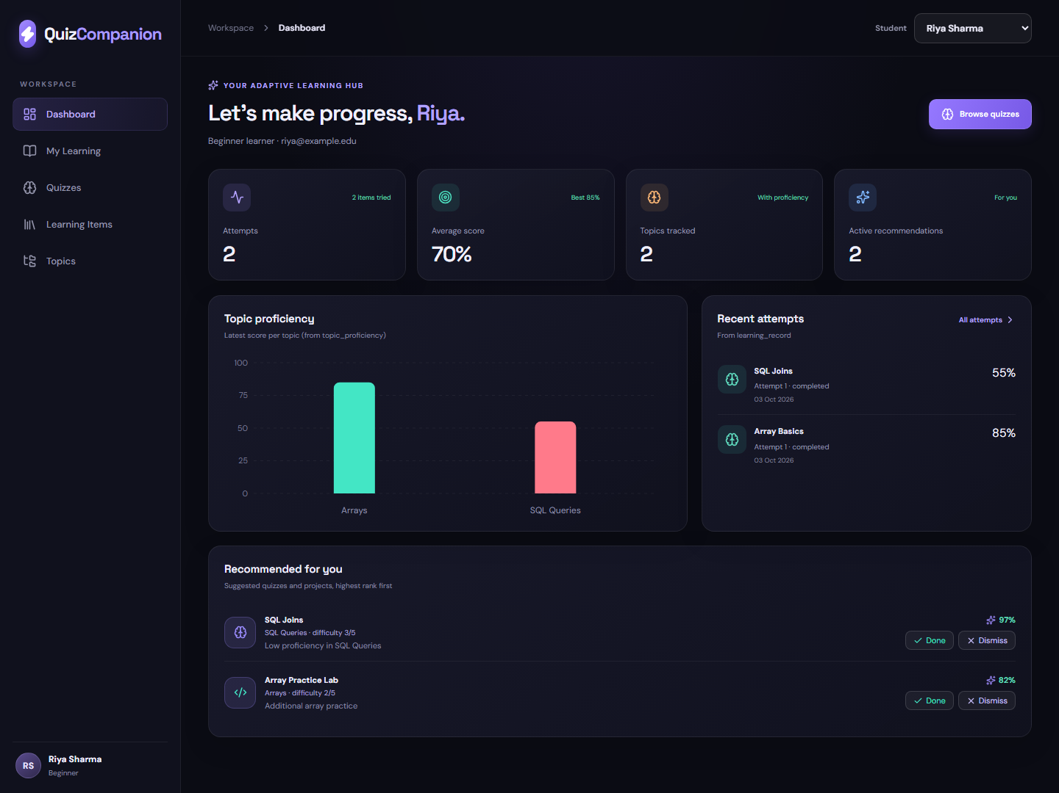
Front-End Design
Part 7 · Front-End Design
Quiz Companion web interface
React 19 + Vite single-page app, styled as a dark dashboard.
Student switcher in the top bar; every page re-queries PostgreSQL for that student.
Dashboard: attempts, average score, topic proficiency chart, recent attempts and ranked recommendations.
Recommendations can be marked Done, Dismissed or Restored (UPDATE on recommendation.status).
No data is hard-coded in the front end: every number comes from the 10 PostgreSQL tables through the API.
Screenshot: Dashboard page running on the sample data from Part 6.
Adaptive Learning Platform · Phase 2 · 17

Slide 18
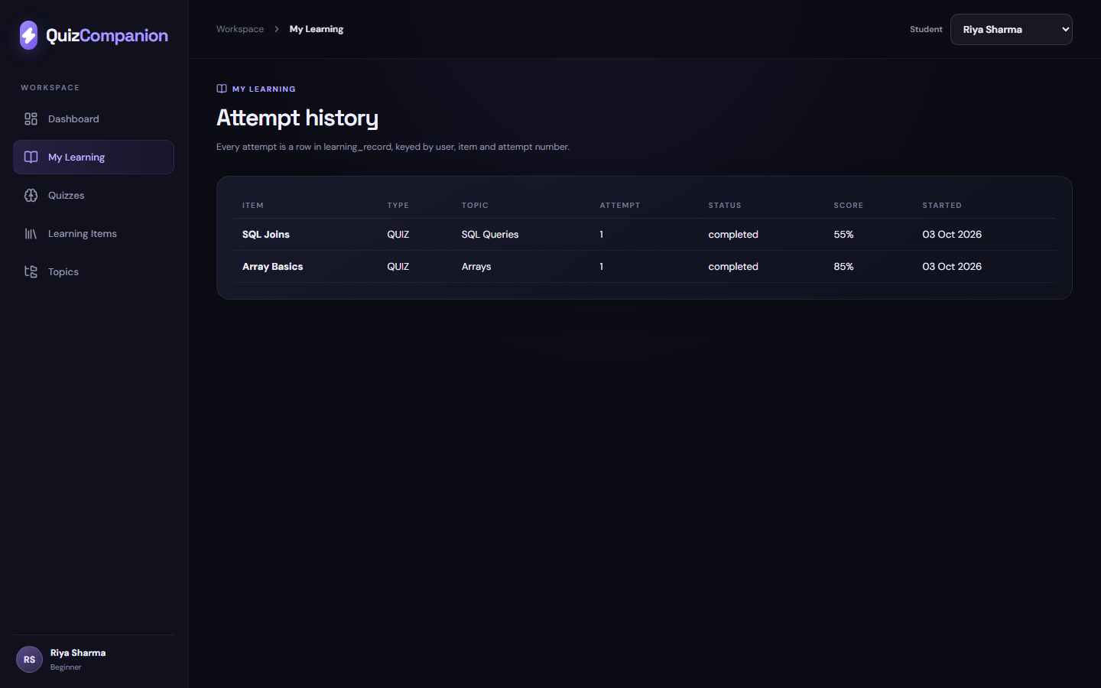
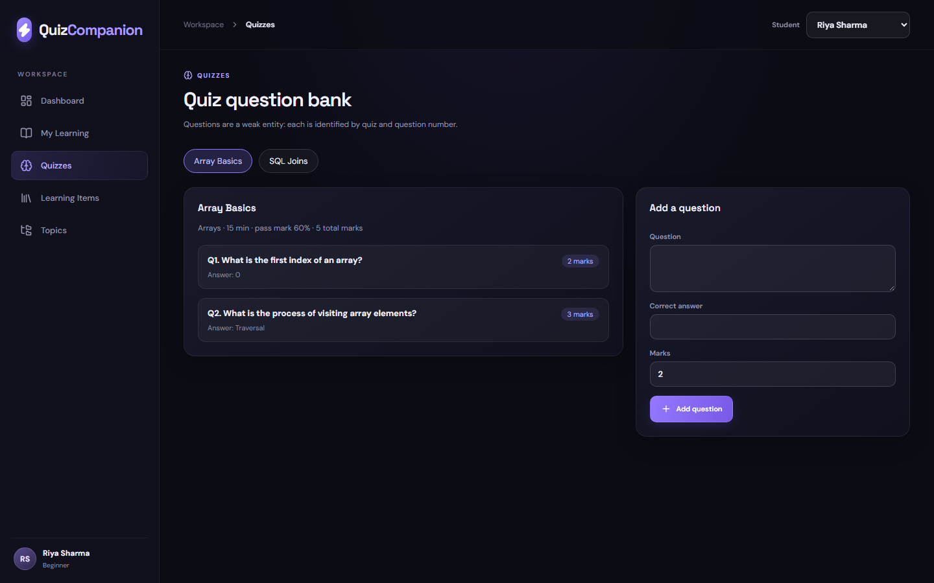
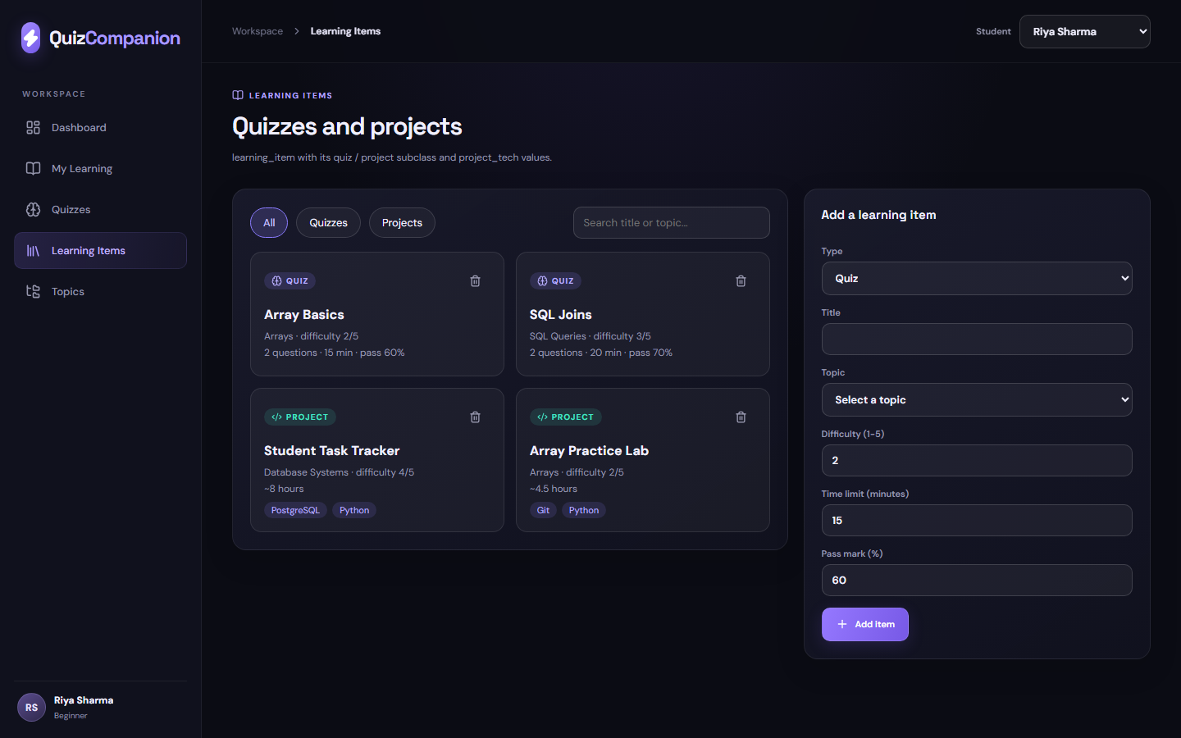
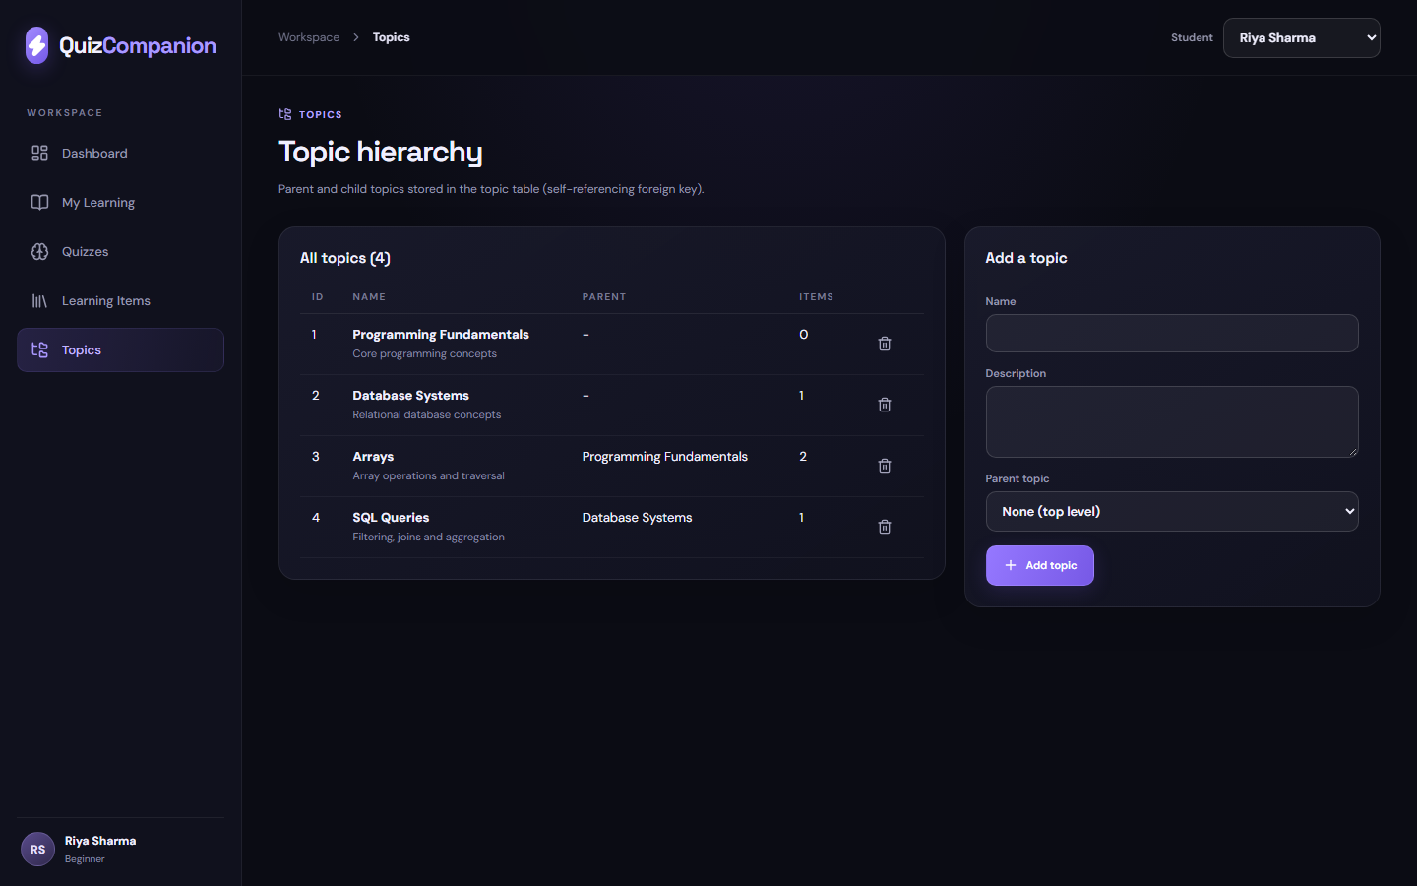
Front-End Pages and Database Use
Part 7 · Front-End Design
Page → tables used
Dashboard
users, learning_record, topic_proficiency, recommendation, learning_item
My Learning
learning_record, learning_item, topic
Quizzes
quiz, question (add questions)
Learning Items
learning_item, quiz, project, project_tech (add / delete)
Topics
topic (add / delete, self-referencing FK)
My Learning: attempt history
Quizzes: question bank (weak entity)
Learning Items: quizzes and projects
Topics: parent / child hierarchy
Adaptive Learning Platform · Phase 2 · 18

Slide 19
Front End to PostgreSQL Connection
Part 9 · Database connectivity (initial)
STEP 1
React page
STEP 2
HTTP /api request
STEP 3
Express route
STEP 4
pg connection pool
STEP 5
PostgreSQL
→
→
→
→
Operation | API call | SQL executed (parameterised)
Retrieve | GET /api/dashboard?userId=1 | SELECT ... FROM learning_record / topic_proficiency / recommendation
Retrieve | GET /api/items | SELECT ... FROM learning_item LEFT JOIN quiz, project, project_tech
Insert | POST /api/items | INSERT INTO learning_item, then quiz or project + project_tech (one transaction)
Insert | POST /api/topics | INSERT INTO topic (name, description, parent_topic_id)
Update | PATCH /api/recommendations/1/2 | UPDATE recommendation SET status = $3
Delete | DELETE /api/topics/3 | DELETE FROM topic; FK violation returned as a 409 message
Test: GET /api/health returns {"status":"ok","database":"connected"}. Connection string comes from DATABASE_URL; scripts: npm run db:setup, npm run server.
Adaptive Learning Platform · Phase 2 · 19

Slide 20
Business Logic: Rules Behind the Front End
Part 8 · Business logic implementation
PostgreSQL constraints, functions and triggers enforce the workflow of the adaptive learning platform
STEP 1
STEP 2
STEP 3
STEP 4
STEP 5
→
→
→
→
Generate recommendations
Validate input
Record attempt
Update proficiency
Find weak topics
Rule | Implemented as
Valid scores, statuses and dates | CHECK constraints
Sequential attempt numbers | record_attempt() function
Proficiency updates after every scored attempt | Trigger on learning_record
Weak topics get recommendations | generate_recommendations() function
Adaptive Learning Platform · Phase 2 · 20

Slide 21
Validation Rules
Part 8 · Business logic implementation
ALTER TABLE · CHECK
Scores must lie between 0 and 100.
An attempt cannot finish before it starts.
Status values come from a fixed list.
Skill levels match the three student levels.
Invalid data is rejected by the database, not only by the front end.
ALTER TABLE learning_record
ADD CONSTRAINT chk_score
CHECK (score BETWEEN 0 AND 100),
ADD CONSTRAINT chk_status
CHECK (status IN ('in_progress',
'submitted','completed')),
ADD CONSTRAINT chk_dates
CHECK (completed_at IS NULL
OR completed_at >= started_at);
ALTER TABLE users
ADD CONSTRAINT chk_skill
CHECK (skill_level IN ('Beginner',
'Intermediate','Advanced'));
ALTER TABLE recommendation
ADD CONSTRAINT chk_rec_status
CHECK (status IN ('active',
'completed','dismissed'));
Adaptive Learning Platform · Phase 2 · 21

Slide 22
Recording an Attempt
Part 8 · Business logic implementation
record_attempt()
The next attempt number is calculated, never typed by the user.
The front end calls one function for quiz attempts and project submissions.
Constraints from the previous slide still validate every row.
CREATE FUNCTION record_attempt(
p_user INT, p_item INT, p_status VARCHAR,
p_score NUMERIC, p_started TIMESTAMP)
RETURNS VOID AS $$
DECLARE v_no SMALLINT;
BEGIN
SELECT COALESCE(MAX(attempt_no), 0) + 1 INTO v_no
FROM learning_record
WHERE user_id = p_user AND item_id = p_item;
INSERT INTO learning_record
(user_id, item_id, attempt_no, status,
score, started_at, completed_at)
VALUES
(p_user, p_item, v_no, p_status,
p_score, p_started, NOW());
END; $$ LANGUAGE plpgsql;
Adaptive Learning Platform · Phase 2 · 22

Slide 23
Grading a Quiz Attempt
Part 8 · Business logic implementation
grade_quiz()
Pass or fail
CREATE FUNCTION grade_quiz(
p_quiz INT, p_answers JSONB)
RETURNS NUMERIC AS $$
SELECT ROUND(100.0 * COALESCE(
SUM(q.marks) FILTER (
WHERE LOWER(p_answers ->> q.question_no::TEXT)
= LOWER(q.correct_answer)), 0)
/ SUM(q.marks), 2)
FROM question q
WHERE q.quiz_id = p_quiz;
$$ LANGUAGE sql;
SELECT grade_quiz(1,
'{"1": "0", "2": "Traversal"}')
>= pass_mark AS passed
FROM quiz WHERE item_id = 1;
Score = marks earned ÷ total marks × 100.
The result is passed to record_attempt() as the score.
pass_mark decides pass or fail.
Adaptive Learning Platform · Phase 2 · 23

Slide 24
Updating Topic Proficiency Automatically
Part 8 · Business logic implementation
fn_update_proficiency()
Trigger
CREATE FUNCTION fn_update_proficiency()
RETURNS TRIGGER AS $$
DECLARE v_topic INT;
BEGIN
SELECT topic_id INTO v_topic
FROM learning_item WHERE item_id = NEW.item_id;
INSERT INTO topic_proficiency
(user_id, topic_id, proficiency_score,
attempts_count, last_updated)
VALUES (NEW.user_id, v_topic, NEW.score, 1, NOW())
ON CONFLICT (user_id, topic_id) DO UPDATE SET
proficiency_score = EXCLUDED.proficiency_score,
attempts_count = topic_proficiency.attempts_count + 1,
last_updated = NOW();
RETURN NEW;
END; $$ LANGUAGE plpgsql;
CREATE TRIGGER trg_update_proficiency
AFTER INSERT ON learning_record
FOR EACH ROW
WHEN (NEW.score IS NOT NULL)
EXECUTE FUNCTION fn_update_proficiency();
Rule: proficiency is the latest attempt score for the topic, and attempts_count increases by 1 each time.
Adaptive Learning Platform · Phase 2 · 24

Slide 25
Identifying Strong and Weak Topics
Part 8 · Business logic implementation
v_topic_strength
user_id | Topic | Score | Strength
1 | Arrays | 85.00 | Strong
1 | SQL Queries | 55.00 | Weak
2 | Arrays | 82.00 | Strong
3 | Database Systems | 90.00 | Strong
CREATE VIEW v_topic_strength AS
SELECT tp.user_id, t.name AS topic,
tp.proficiency_score,
CASE
WHEN tp.proficiency_score >= 80 THEN 'Strong'
WHEN tp.proficiency_score >= 70 THEN 'Average'
ELSE 'Weak'
END AS strength
FROM topic_proficiency tp
JOIN topic t ON t.topic_id = tp.topic_id;
Expected output for the Part 6 sample data.
Weak (below 70) matches the threshold used by generate_recommendations().
Adaptive Learning Platform · Phase 2 · 25

Slide 26
Generating Recommendations for Weak Topics
Part 8 · Business logic implementation
generate_recommendations()
A topic is weak when proficiency is below 70.
Lower proficiency gives a higher rank score.
Items already recommended to the student are skipped.
This is a rule-based method; Qdrant similarity search can refine it later.
CREATE FUNCTION generate_recommendations(p_user INT)
RETURNS VOID AS $$
INSERT INTO recommendation
(user_id, item_id, rank_score,
reason, status, created_at)
SELECT tp.user_id, li.item_id,
ROUND((100 - tp.proficiency_score) / 100, 4),
'Low proficiency in ' || t.name,
'active', NOW()
FROM topic_proficiency tp
JOIN topic t ON t.topic_id = tp.topic_id
JOIN learning_item li ON li.topic_id = tp.topic_id
WHERE tp.user_id = p_user
AND tp.proficiency_score < 70
ON CONFLICT (user_id, item_id) DO NOTHING;
$$ LANGUAGE sql;
Adaptive Learning Platform · Phase 2 · 26

Slide 27
Leaderboard
Part 8 · Business logic implementation
v_leaderboard
Rank | Student | Total
1 | Riya Sharma | 140.00
2 | Maya Iyer | 90.00
3 | Arjun Mehta | 82.00
CREATE VIEW v_leaderboard AS
SELECT u.user_id, u.full_name,
SUM(b.best_score) AS total_score,
RANK() OVER (
ORDER BY SUM(b.best_score) DESC) AS rank
FROM users u
JOIN (SELECT user_id, item_id,
MAX(score) AS best_score
FROM learning_record
WHERE status IN ('completed', 'submitted')
GROUP BY user_id, item_id) b
ON b.user_id = u.user_id
GROUP BY u.user_id, u.full_name;
Expected output for the sample data. Only each student's best score per item counts.
Redis sorted sets can cache this ranking for fast reads; PostgreSQL stays the source of truth.
Adaptive Learning Platform · Phase 2 · 27

Slide 28
Account and Administrator Rules
Part 8 · Business logic implementation
register_user()
fn_block_topic_delete()
CREATE FUNCTION register_user(
p_name VARCHAR, p_email VARCHAR,
p_hash VARCHAR)
RETURNS INT AS $$
INSERT INTO users (full_name, email,
password_hash, skill_level, created_at)
VALUES (p_name, p_email, p_hash,
'Beginner', NOW())
RETURNING user_id;
$$ LANGUAGE sql;
CREATE FUNCTION fn_block_topic_delete()
RETURNS TRIGGER AS $$
BEGIN
IF EXISTS (SELECT 1 FROM learning_item
WHERE topic_id = OLD.topic_id) THEN
RAISE EXCEPTION
'Topic % still has learning items', OLD.topic_id;
END IF;
RETURN OLD;
END; $$ LANGUAGE plpgsql;
CREATE TRIGGER trg_block_topic_delete
BEFORE DELETE ON topic FOR EACH ROW
EXECUTE FUNCTION fn_block_topic_delete();
Registration: a duplicate email is rejected by the UNIQUE constraint; the application hashes the password before calling the function; new students start as Beginner.
Administration: a topic that still has learning items cannot be deleted, and the trigger gives a clear error message.
Adaptive Learning Platform · Phase 2 · 28

Slide 29
Redis and Qdrant: Integration Plan
Part 8 · Business logic implementation
STEP 1
STEP 2
STEP 3
STEP 4
STEP 5
→
Trigger updates proficiency
→
Leaderboard cache refreshed
→
Student vector updated
→
Recommendations served
Attempt recorded
Component | Role | Requirements
PostgreSQL | Source of truth for all 10 tables, constraints, triggers and views | FR1–FR9, FR12
Redis | Leaderboard sorted sets and cache for frequent reads | FR10, FR11
Qdrant | Vectors for items and student skill profiles to find similar quizzes and projects | FR9
Adaptive Learning Platform · Phase 2 · 29

Slide 30
Testing the Business Rules
Part 8 · Business logic implementation
Test statements
Test | Expected result
Valid attempt | Row added with attempt_no 1; proficiency updated
Score of 120 | Rejected by chk_score
Proficiency check | Topic score and attempt count updated
Recommendations | Rows for topics scoring below 70
SELECT record_attempt(1, 3, 'submitted',
88, LOCALTIMESTAMP);
SELECT record_attempt(1, 3, 'submitted',
120, LOCALTIMESTAMP);
SELECT * FROM topic_proficiency
WHERE user_id = 1;
SELECT generate_recommendations(2);
record_attempt(1,3,'submitted',88) -> OK, attempt_no 1
record_attempt(1,3,'submitted',120) -> ERROR: violates check constraint "chk_score"
topic_proficiency user 1: topic 2 = 88.00 (1 attempt)
after record_attempt(2,2,'completed',45): generate_recommendations(2) -> SQL Joins, 0.5500
Adaptive Learning Platform · Phase 2 · 30

Slide 31
Conclusion and Next Steps
Conclusion
Area | Phase 2 coverage
Database design | 10 PostgreSQL tables with keys and constraints, consistent with Phase 1
Data population | Sample data for all 10 tables
Business logic | Validation, attempt recording, grading, proficiency, recommendations, leaderboard and admin rules
Front end | React web app with five pages (dashboard, attempts, quizzes, learning items, topics) reading live PostgreSQL data
Initial connectivity | Express + pg connection pool: SELECT, INSERT, UPDATE and DELETE run from the front end
Next step | Phase 3: complete JDBC/ODBC CRUD integration, testing and live demonstration
Adaptive Learning Platform · Phase 2 · 31

